Slide 2
High and Maximum WAF Security
Thursday, August 16, 2018
Chad Fazio – Systems Engineer West
Jesse Darrone – Systems Engineer East
Brian Breyfogle – Systems Engineer West
Last Updated: 2018-8-10
© F5 Networks

Slide 3
HIGH Protection
Increased Security
Session enforcement

Slide 4
Session Enforcement: High Protection
Goal: Additional security, session enforcement
Allowed URL list
User session tracking
Session hijacking protection
Brute force attack protection
Blocking mode override

Slide 5
Allowed URL list - Overview
Allows for the creation a whitelist of URL that should be accessed
Can either be explicit or wildcard

Slide 6
Allowed URL list – Recommended Practices
Provide ASM with whitelist or use learning
Wildcard (*) must be removed from the URL list
Use transparent enforcement for a period to validate the URL list
Or put in blocking and disable the blocking or illegal URLs
For significant updates, transition back to Transparent
https://support.f5.com/csp/article/K29418033

Slide 7
User session tracking - Overview
Allows for a session to be tracked over a stateless application or tracking an application and additional enforcement for a session based application
Allows for login page protection
Brute Force Protection

Slide 8
User session tracking – Recommended Practices
Add login pages to security policy which automatically creates a association between the username used and logs
Brute Force Protection should be considered
https://support.f5.com/csp/article/K02212345

Slide 9
Session hijacking protection - Overview
Sessions are typically hijacked by obtaining the value of a legitimate session
ASM uses browser fingerprinting,
This allows ASM ito create a unique device ID to track the user session
If suspicious activity occurs such as a change in source IP, ASM can validate against the device ID

Slide 10
Session hijacking protection – Recommended Practices
Enable session awareness and session hijacking protection
Run in transparent and monitor policy for false positives before putting into blocking
https://support.f5.com/csp/article/K40120684

Slide 11
Brute force attack protection - Overview
Because hackers continually change their brute force attack strategies in response to detection and mitigation technology
The BIG-IP ASM system now detects these attacks based on:
User names that have multiple failed login attempts
User device IDs, captured through browser fingerprinting
User IP addresses

Slide 12
Brute force attack protection – Recommended Practices
Add all login pages to the policy
Policy builder now supports the ability to detect automatically
Monitor logs for Brute Force Attacks and prune false positives

Slide 13
Blocking mode override - Overview
Allows for a for unfettered access to the application while the policy is in blocking mode
Uses hostname
Used for testing a new revision of the app
Penetration testing
Transparent mode
Learning and alerts occur

Slide 14
Blocking mode override – Recommended Practices
you must protect the hostname to ensure that malicious traffic from adversarial sources cannot exploit the Blocking enforcement override. Some strategies include:
Maintaining secrecy around the hostname
Ensuring regular rotation of the hostname
Restricting access to the hostname with a whitelisted set of IP addresses or subnets using controls in local traffic policies or iRules

Slide 15
Maximum Protection
Further Tightening

Slide 16
TIGHTENING SECURITY: Maximum Protection
Goal: Tighten web application behavior
Data Guard
DAST Integration
Protection from parameter exploits – whitelisting
Allowed HTTP request methods

Slide 17
Data Guard - Overview
A per page response check
Can check for SSN, CC numbers in webserver response
If detected, the values can be masked out and send an alert

Slide 18
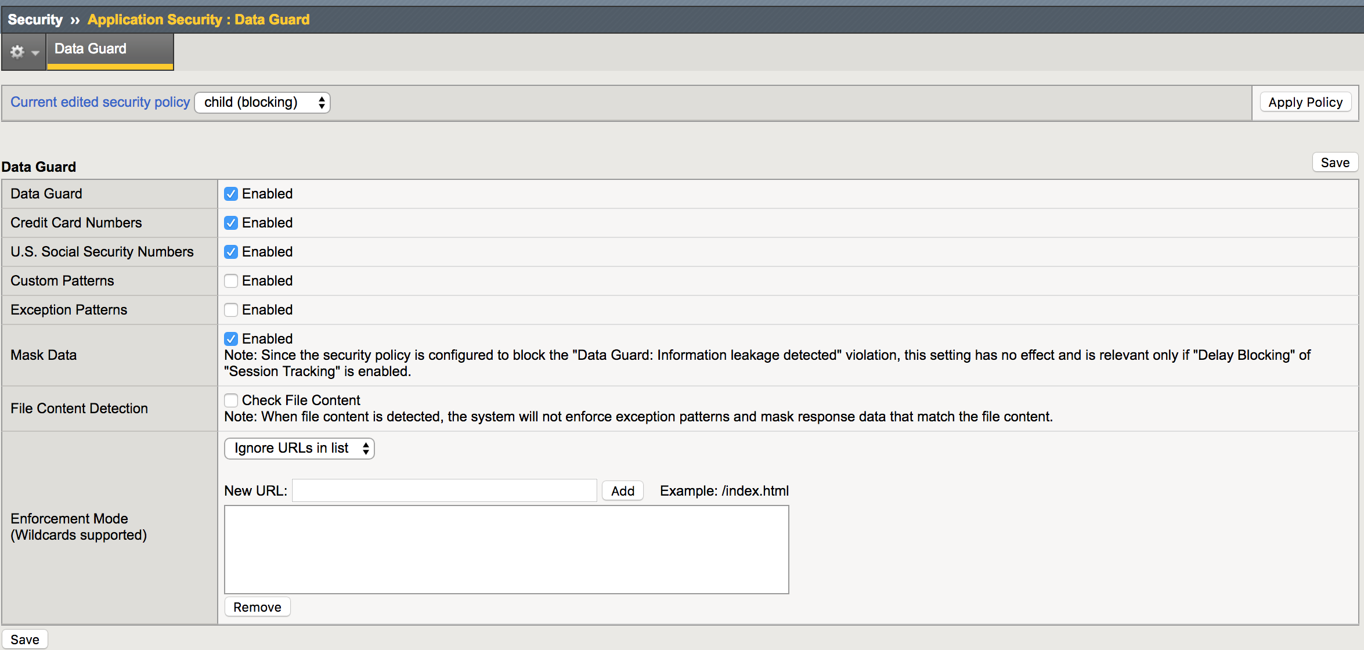
Data Guard - GUI

Slide 19
Data Guard – Recommended Practices
Do not enable Data Guard on every url
Only enable on select url where CC, SSN #s could be present
Data Guard is very CPU intensive

Slide 20
DAST - Overview
A per page response check
Supported scanners include:
Generic (eg. Nessus/Tenable, supported via xml template)
HP WebInspect
IBM AppScan
ImmuniWeb
Qualys
Quotium Seeker
Trustwave App Scanner (formerly Cenzic)
WhiteHat Sentinnel

Slide 21
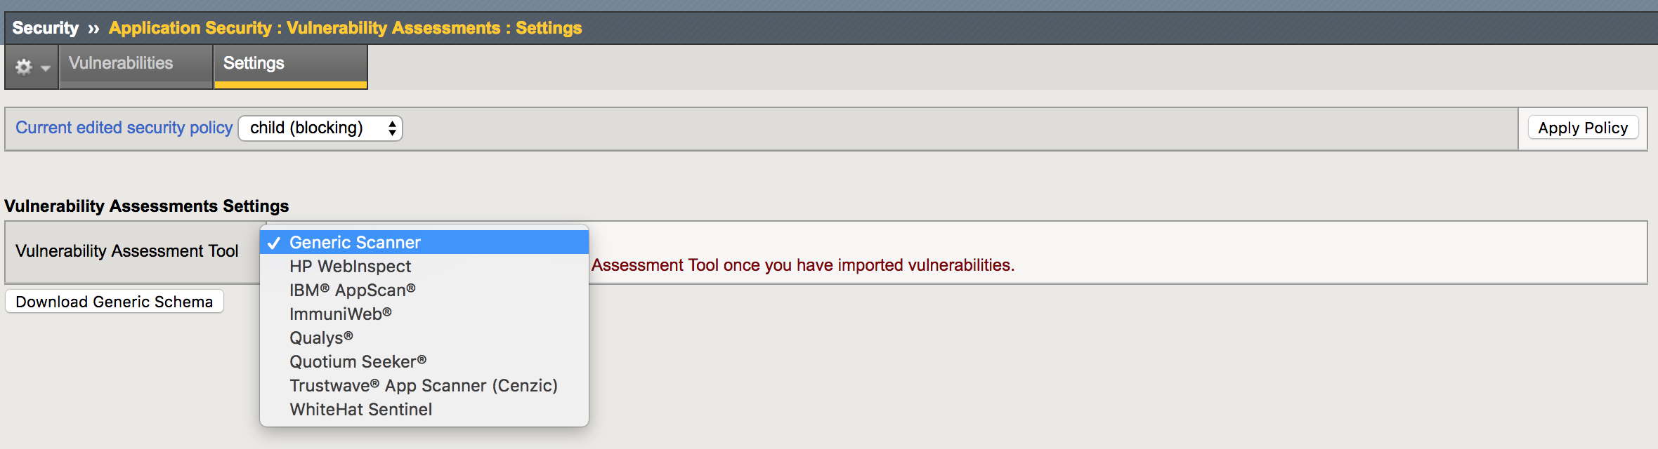
DAST - GUI

Slide 22
DAST – Recommended Practices
DAST integration is an excellent way to get a base policy quickly and efficiently
Configure the IP address(es) of the scanner(s) in the IP address exception section

Slide 23
Protection from parameter exploits – whitelisting - Overview
Builds a comprehensive list of parameters
The parameters are then tightened by applying max length and data type for its value

Slide 24
Protection from parameter exploits – whitelisting – Recommended Practices
Enable Policy Builder to identify parameters
Do not restrict parameters to only those that are learned
Doing so increases administrative effort due to application changes
The security provided is insignificant
Enable signature detection

Slide 25
Allowed HTTP request methods - Overview
By default, the following methods are allowed:
GET
POST
HEAD, which ASM changes to GET
Other requests cause a violation

Slide 26
Allowed HTTP request methods– Recommended Practices
Most websites only use GET and POST
Use learning to detect whether other methods are used

Slide 27
API Security

Slide 28
Securing API with ASM
The following demonstrates some examples of protecting a JSON API (the BIGIP Restful API)
API calls are web traffic, so almost all of the security features ASM provides apply

Slide 29
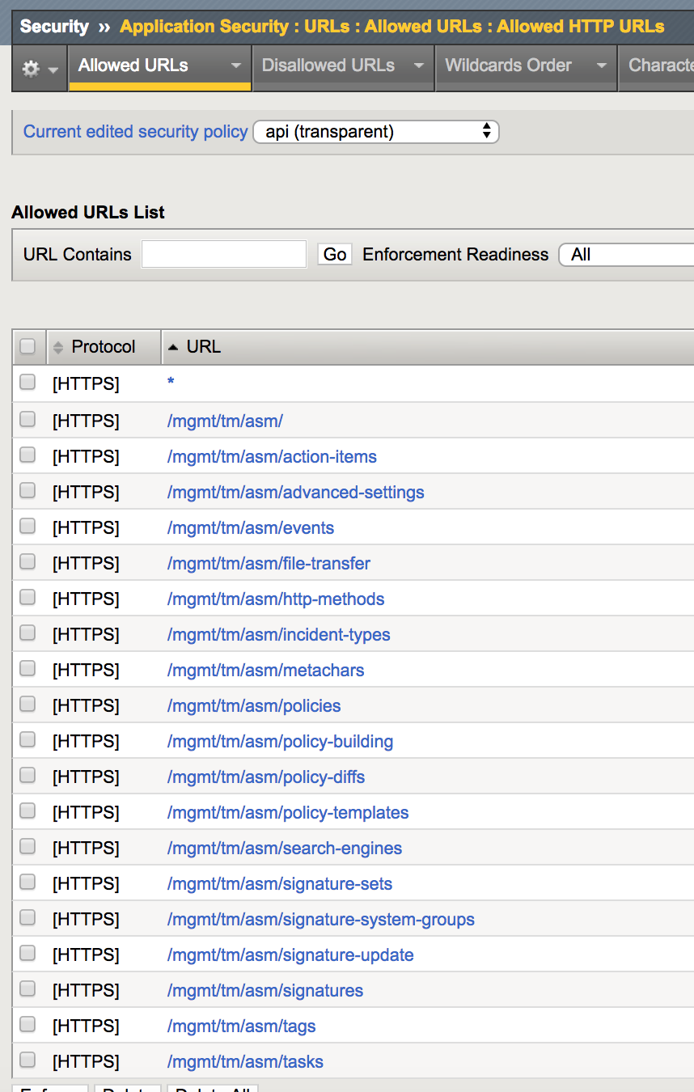
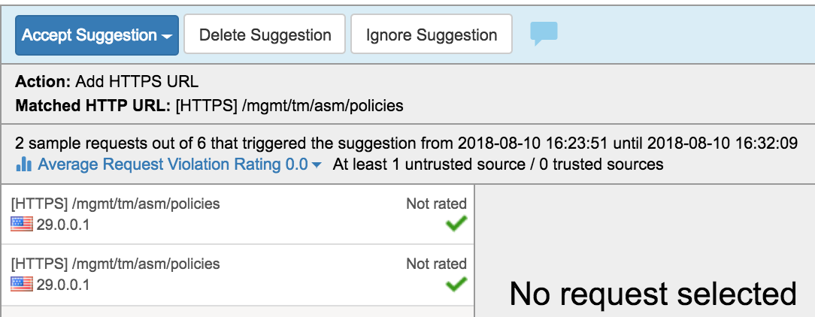
Learn API URL
URLs in Restful API represents configuration objects
This allows for control over what object can be viewed and modified

Slide 30
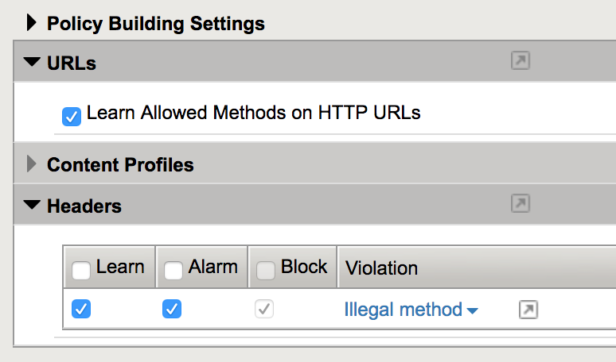
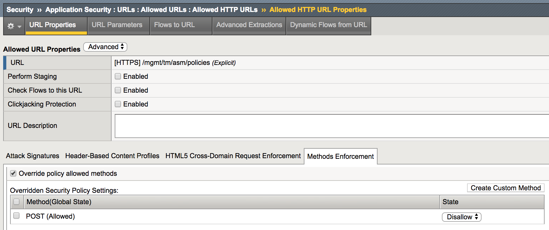
LIMIT REST COMMANDS/HTTP METHODS PER URL
E.g. Disallow new ASM policies from being created
POST is used to create ASM policies, prohibit the command on the policies URL

Slide 31
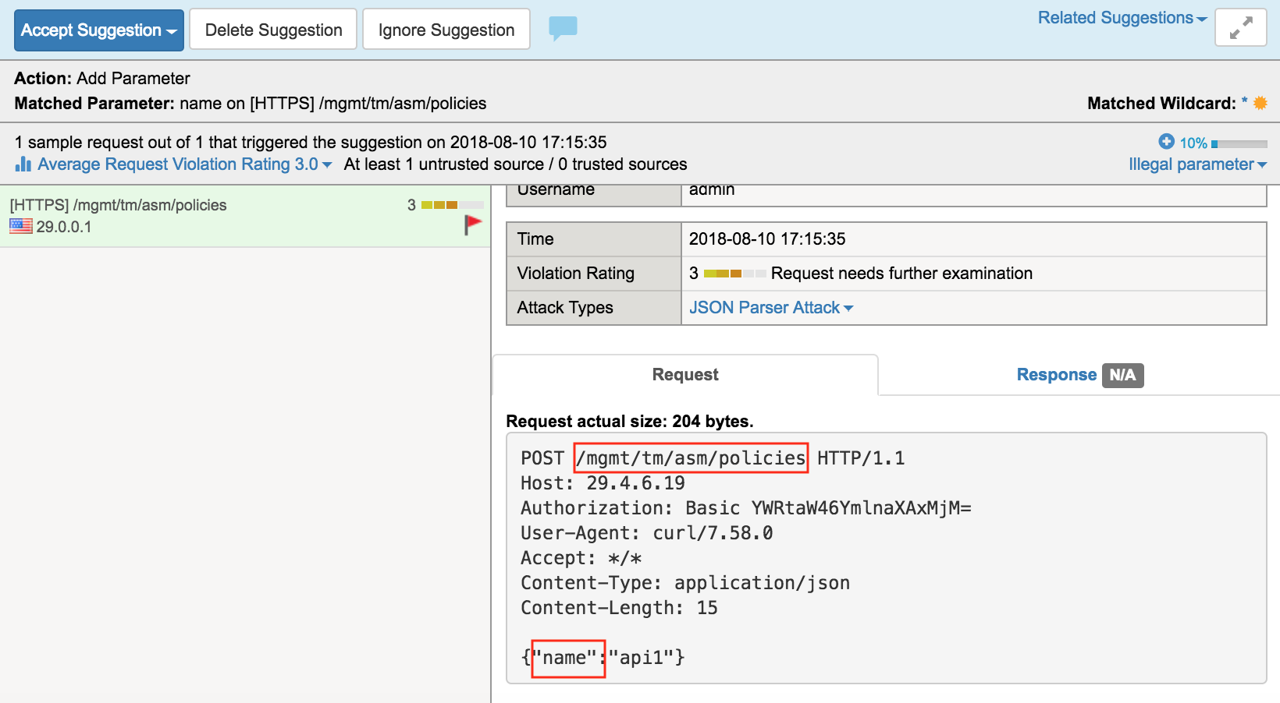
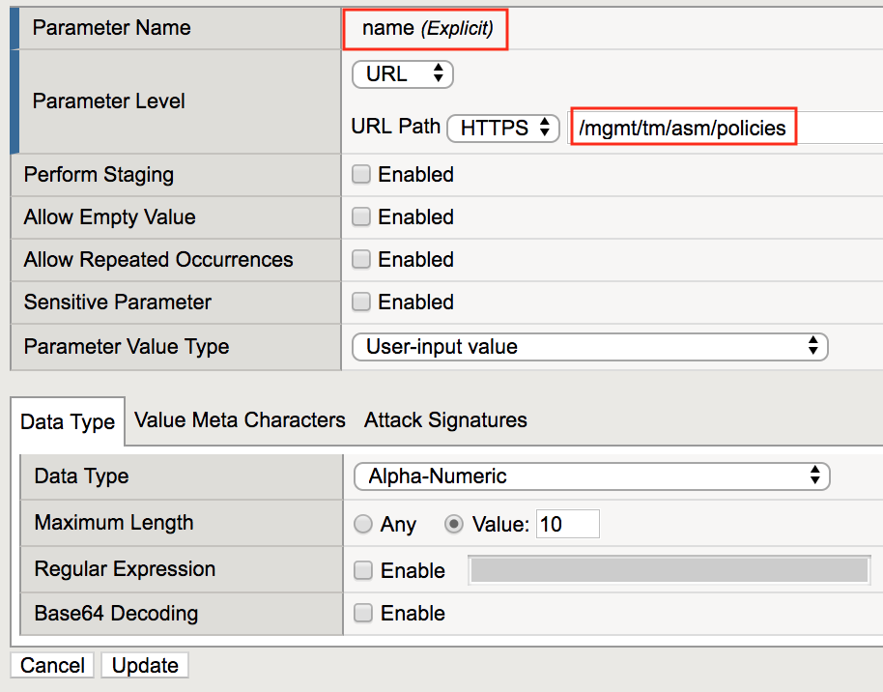
Learn JSON Parameters/Keys
JSON keys represent configuration fields within an configuration object
JSON keys are treated as parameters
Learned JSON keys can be added to the policy on per-URL basis as parameters
Controlling parameters per-URL allows for fine-grained control over what objects can be created and modified

Slide 32
Control JSON Input/Values
Restrict JSON input to parameters using length restrictions, regular expressions and/or Meta Character restrictions

Slide 33
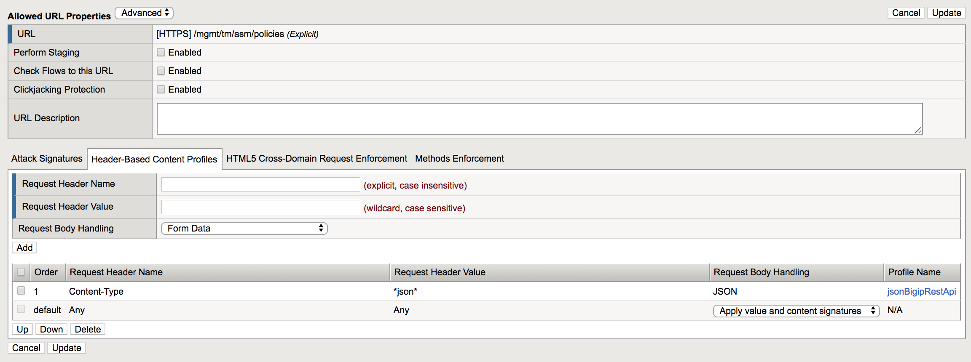
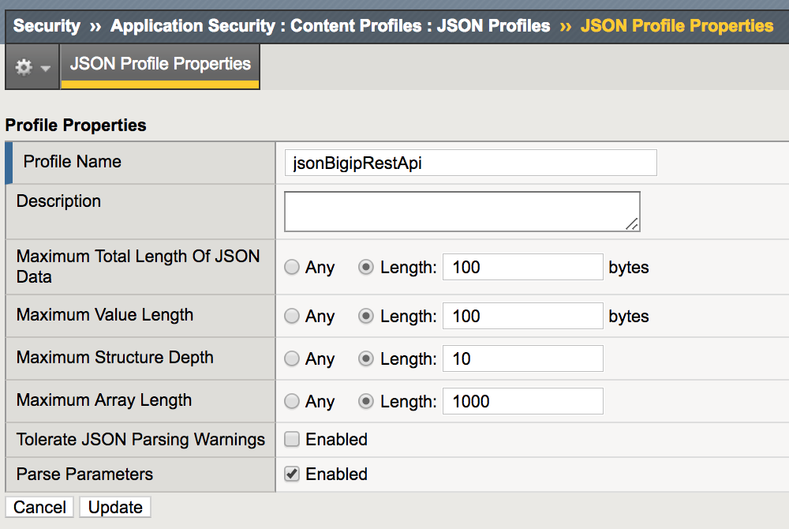
JSON Profiles Per URL
Define JSON payload limits

Slide 34
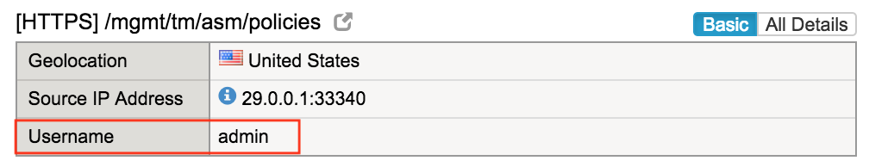
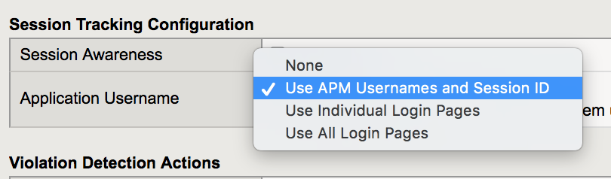
Identity
Using either ASM Login Pages/Sessions Tracking and/or APM authentication methods, user identity can be tied to requests and access
Can be used to restrict access based on user identity

Slide 35
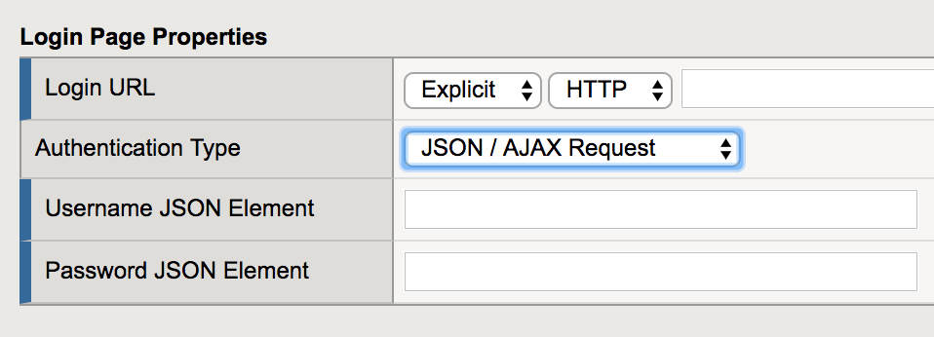
Brute force login protection
The login form can be submitted as an AJAX POST request with the login details and response in JSON format.
The automatic policy builder can learn AJAX login pages without manual intervention and protect them automatically.

Slide 36
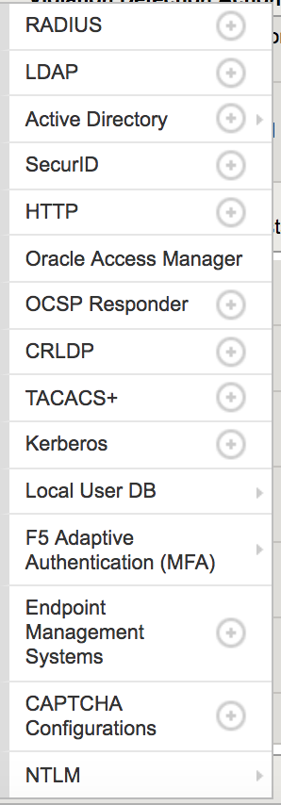
Enforce stronger/additional authentication methods with APM
Enforce multi-factor authentication such as client cert, Active/Directory Auth, etc

Slide 37


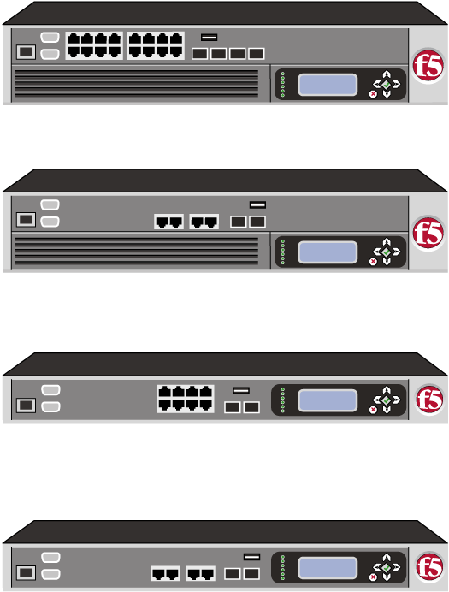

Use Case OAuth for API Authorization
(1)
Partner Network
Problems
(2)
(3)
Partner Application
Active Directory
Access to user authorized information hosted on another site
Compliance and liability challenges – How to protect credentials and the data
(4a)
(5)
(6)
APM As
Resource Server
Enterprise Web Applications
(4b)
APM as Authorization Server
Enterprise Network
Active Directory
Solution
Either or both:
APM OAuth Resource Server authorizes web APIs
APM OAuth Authorization server grants tokens
App to app communication via APIs can be protected, and initial consent via user authorization be requested
Use Cases
Authorization Server
US Retail company allowing inventory and pricing exchange
Bank in Europe for Realtors’ mortgage calculator
Notes:
Partner User accesses an application on the partner network.
User authenticates with AD in the partner network.
User starts using the partner application
Now the partner application needs to update an information on the enterprise resource on behalf of the partner user, for example updating the inventory/pricing information of the items supplied by the partner. Partner application authenticates the application with the APM AS hosted in the enterprise network using the user password credential grant by sending the credentials created for the partner. Upon successful authentication, an access token is returned to the partner application.
Partner application invokes an API call on the enterprise network using the access token.
RS component validates the access token and allows the API call.

Slide 38
References

Slide 39
References
Succeeding with application security
https://support.f5.com/csp/article/K07359270
OWASP Top 10 2017
https://devcentral.f5.com/articles/big-ip-asm-and-the-owasp-top-10-2017-28911
ASM Operations Guide
https://support.f5.com/kb/en-us/products/big-ip_asm/manuals/product/f5-asm-operations-guide.html

Slide 40
Thank You

